Slide 1
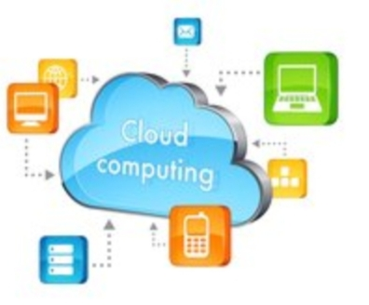
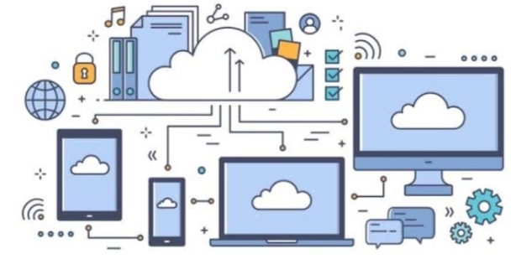
CLOUD COMPUTING

Slide 2
TABLE OF CONTENTS
Introduction
Why cloud computing
Service models
Deployment model
Advantages and Disadvantages

Slide 3

Introduction
Cloud computing is the use of the hardware and software to deliver a service over a network (typically the Internet). With cloud computing, users can access files and use applications from any device that can access the internet.
The “ cloud” is a set of different type of hardware and software that works collectively to deliver many aspects of computing to the end-user as an online services

Slide 4
Why cloud computing
With increase in computers and mobile user’s data storage has become a priority in all fields.
Large and small scale businesses thrive on their data & they spent a huge amount of money to maintain this data.
It requires a strong IT support and a storage hub. Not all businesses can afford high cost of in-house IT infrastructure and back up support services.

Slide 5
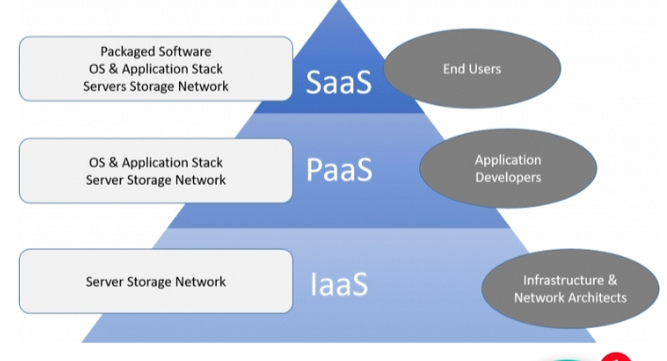

Slide 6
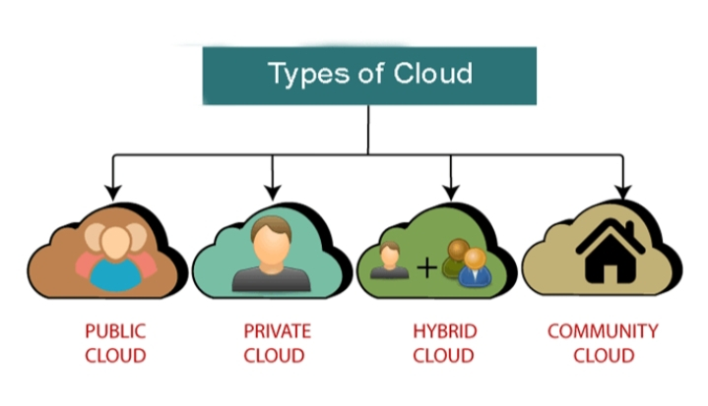

Slide 7
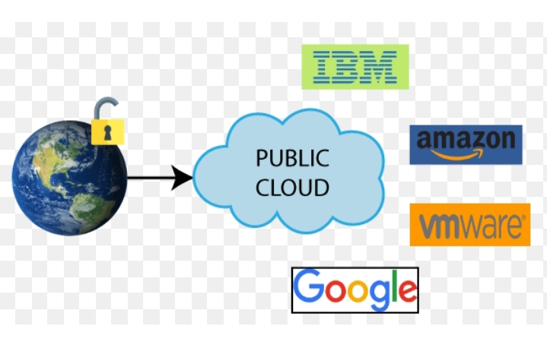
PUBLIC CLOUD
Public cloud provides a shared platform that is Accessible to the general public through an internet connection.
All the data will be accessible to the entire public
The biggest IT companies like IBM (International Business Machines), Amazon, Google they all are using public clouds

Slide 8
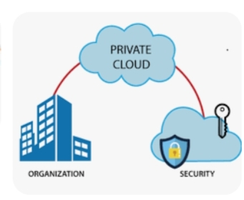
PRIVATE CLOUD
Private cloud has more security and it limited to particular organization.
Private cloud is also known as an internal cloud or corporate cloud

Slide 9
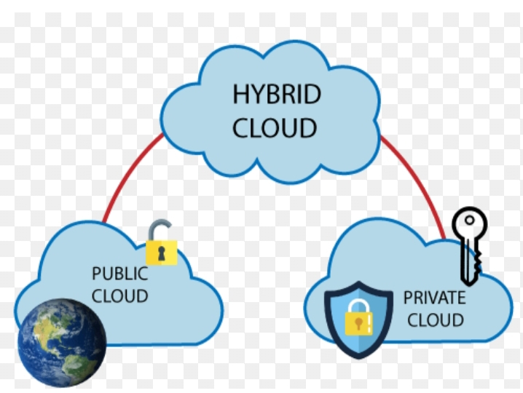
HYBRID CLOUD
Hybrid cloud is a combination of public cloud and private cloud.
Hybrid cloud=public cloud + private cloud
Public cloud is accessible to entire public and it can be secure.
Private cloud is accessible to particular organisation and data in private cloud more secure than the public cloud.

Slide 10
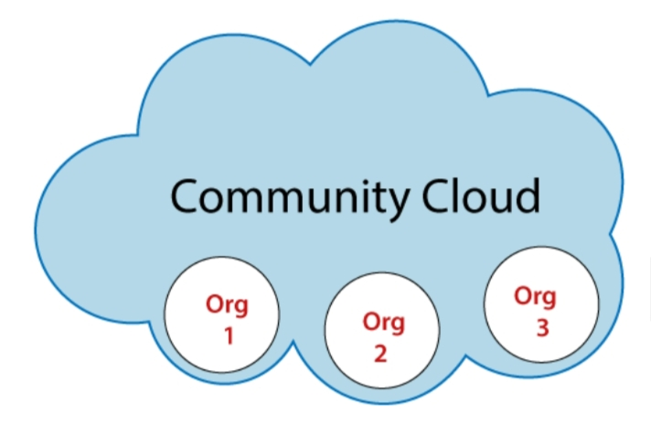
COMMUNITY CLOUD
Community cloud is a cloud infrastructure that allows system and services.
Org 1,org 2, org 3 are combinedly using community cloud

Slide 11
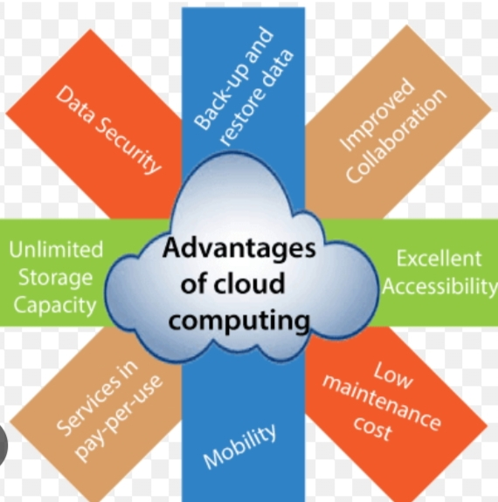

Slide 12
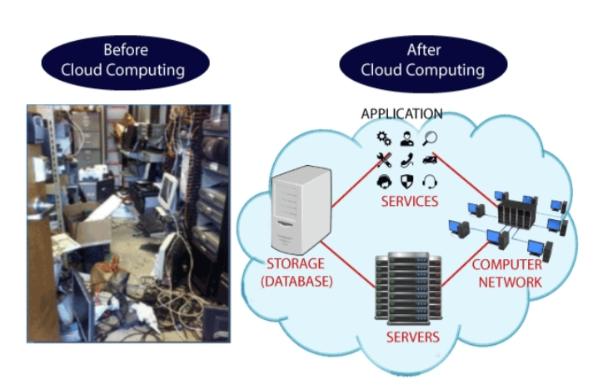
DISADVANTAGE
Does not work with low-speed connection
Little security issues

Slide 13
Thank You …

